Slide 1
How Browser Works
Introduction
Render engines
Parsing
DOM tree Construction
HTML Parsing
CSS parsing
Resources

Slide 2
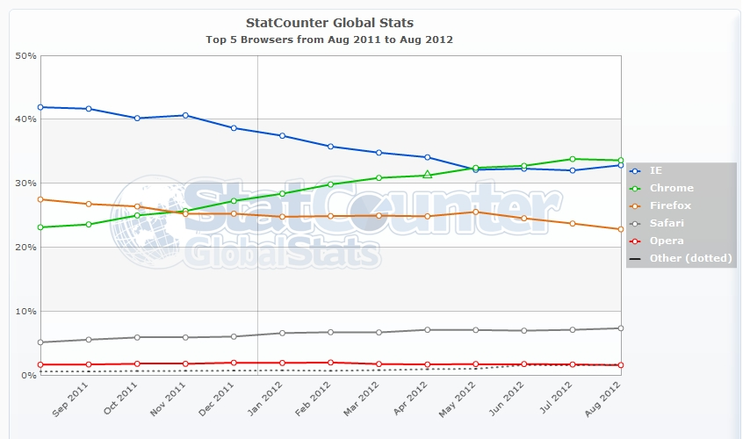
Introduction
90% of web users uses the following Five popular browsers:
Internet Explorer
Firefox
Safari
Chrome
Opera

Slide 3
http://www.evolutionoftheweb.com/

Slide 4
Browser’s main Functionality
Present the web resource
Resource is specified by the user using a URI
browser interprets and displays HTML files is specified in the HTML and CSS specifications
The location of the resource is specified by the user using a URI (Uniform resource Identifier)
W3C (World Wide Web Consortium) organization, which is the standards organization for the web.

Slide 5
Continue…..(Browsers' user interface)
Address bar for inserting the URI
Back and forward buttons
Bookmarking options
A refresh and stop buttons for refreshing and stopping the loading of current documents
Home button

Slide 6
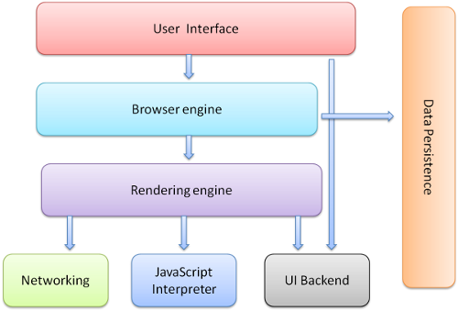
Continue…(Browser's high level structure)

Slide 7
Browser's high level structure
The browser's main components are :
The user interface - this includes the address bar, back/forward button, bookmarking menu etc. Every part of the browser display except the main window where you see the requested page.
The browser engine - marshalls the actions between the UI and the rendering engine.
The rendering engine - responsible for displaying the requested content. For example if the requested content is HTML, it is responsible for parsing the HTML and CSS and displaying the parsed content on the screen.
Networking - used for network calls, like HTTP requests. It has platform independent interface and underneath implementations for each platform.
UI backend - used for drawing basic widgets like combo boxes and windows. It exposes a generic interface that is not platform specific. Underneath it uses the operating system user interface methods.
JavaScript interpreter. Used to parse and execute the JavaScript code.
Data storage. This is a persistence layer. The browser needs to save all sorts of data on the hard disk, for examples, cookies. The new HTML specification (HTML5) defines 'web database' which is a complete (although light) database in the browser.

Slide 8
Rendering Engines
The responsibility of the rendering engine is to display of the requested contents on the browser screen.
By default the rendering engine can display:
HTML contents
CSS
PDF
Images, etc

Slide 9
Continue…..
Firefox uses Gecko - a "home made" Mozilla rendering engine.
Both Safari and Chrome use Webkit (webkit.org).

Slide 10

Rendering Engine (main flow)
The rendering engine will start getting the contents of the requested document from the networking layer.
The rendering engine will start parsing the HTML document and turn the tags to DOM nodes in a tree called the "content tree". It will parse the style data, both in external CSS files and in style elements.
The styling information together with visual instructions in the HTML will be used to create another tree - the render tree.

Slide 11
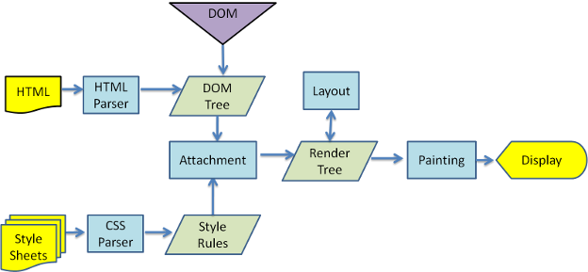
Webkit main flow

Slide 12
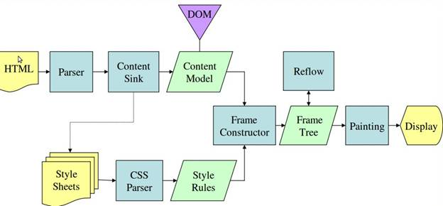
Mozilla Gecko main Flow

Slide 13
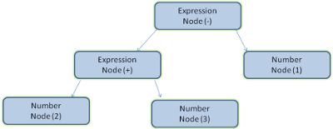
Parsing
Parsing a document means translating it to some structure that makes sense.
The result of parsing is usually a tree of nodes that represent the structure of the document. It is called a parse tree or a syntax tree.
Example: 2 + 3 – 1

Slide 14
Continue…
Formal definitions for vocabulary and syntax
Vocabulary is usually expressed by regular expressions
Example of regular expressions:
\b[A-Z0-9._%+-]+@[A-Z0-9.-]+\.[A-Z]{2,4}\b
This regular expression can be used for getting email address is exact.

Slide 15
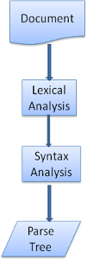
Continue… (Grammar)
Parsing is based on the syntax rules the document obeys
Parser - Lexer combination
lexical analysis: Lexical analysis is the process of breaking the input into tokens. Tokens are the language vocabulary - the collection of valid building blocks. In human language it will consist of all the words that appear in the dictionary for that language.
syntax analysis: Syntax analysis is the applying of the language syntax rules.

Slide 16
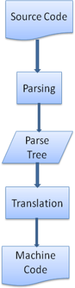
Continue… (Grammar)
Translation
Parsing is often used in translation - transforming the input document to another format.
Compilation flow

Slide 17
Parsing example
Vocabulary: Our language can include integers, plus signs and minus signs.
Syntax:
The language syntax building blocks are expressions, terms and operations.
Our language can include any number of expressions.
An expression is defined as a "term" followed by an "operation" followed by another term
An operation is a plus token or a minus token
A term is an integer token or an expression

Slide 18
Continue
Syntax is usually defined in a format called BNF.
BNF: Backus–Naur Form is one of the two main notation techniques for context-free grammars, often used to describe the syntax of languages used in computing, such as computer programming languages, document formats, instruction sets and communication protocol; the other main technique for writing context-free grammars is the van Wijngaarden form. They are applied wherever exact descriptions of languages are needed: for instance, in official language specifications, in manuals, and in textbooks on programming language theory.
Many extensions and variants of the original Backus–Naur notation are used; some are exactly defined, including Extended Backus–Naur Form (EBNF) and Augmented Backus–Naur Form (ABNF).

Slide 19
Example of BNF
As an example, consider this possible BNF for a U.S. postal address:
<postal-address> ::= <name-part> <street-address> <zip-part>
<name-part> ::= <personal-part> <last-name> <opt-suffix-part> <EOL> | <personal- part> <name-part>
<personal-part> ::= <first-name> | <initial> "."
<street-address> ::= <house-num> <street-name> <opt-apt-num> <EOL>
<zip-part> ::= <town-name> "," <state-code> <ZIP-code> <EOL>
<opt-suffix-part> ::= "Sr." | "Jr." | <roman-numeral> | ""

Slide 20
Continue
Webkit uses two well known parser generators –
Flex¹ for creating a lexer
Bison² for creating a parser (you might run into them with the names Lex and Yacc).
Flex input is a file containing regular expression definitions of the tokens. Bison's input is the language syntax rules in BNF format.
http://en.wikipedia.org/wiki/Flex_lexical_analyser
http://www.gnu.org/software/bison/

Slide 21
DOM (Document Object Model)
The output tree - the "parse tree" is a tree of DOM element and attribute nodes.
The DOM has an almost one-to-one relation to the markup.

Slide 22
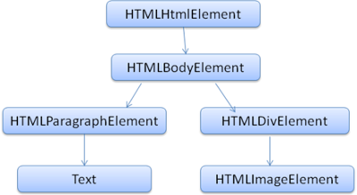
DOM Tree Construction
<html>
<body>
<p>
Hello World
</p>
<div>
<img src="example.png"/>
</div>
</body>
</html>

Slide 23
Parsing Algorithm
HTML cannot be parsed using the regular top down or bottom up parsers.
The reasons are:
The forgiving nature of the language.
The fact that browsers have traditional error tolerance to support well known cases of invalid HTML.
The parsing process in reentrant. Usually the source doesn't change during parsing, but in HTML, script tags containing document.write can add extra tokens, so the parsing process actually modifies the input.

Slide 24
Continue….PA
The algorithm consists of two stages –
Tokenization
Tree construction

Slide 25
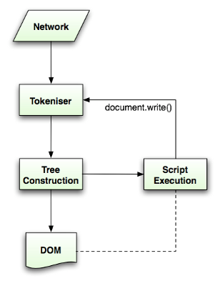
Tokenization
Tokenization is the lexical analysis, parsing the input into tokens. Among HTML tokens are start tags, end tags, attribute names and attribute values.
The tokenizer recognizes the token, gives it to the tree constructor, and consumes the next character for recognizing the next token, and so on until the end of the input.

Slide 26
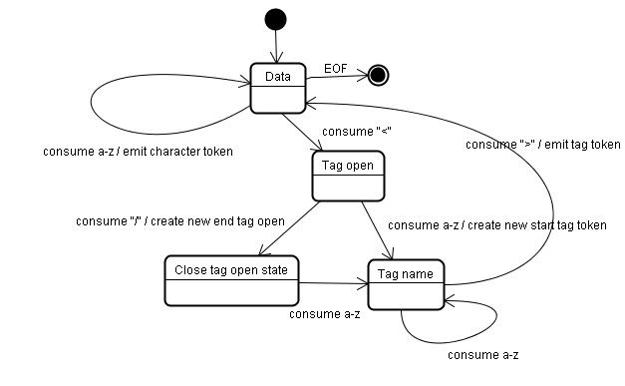
Example (Tokenization)
<html>
<body>
Hello world
</body>
</html>

Slide 27
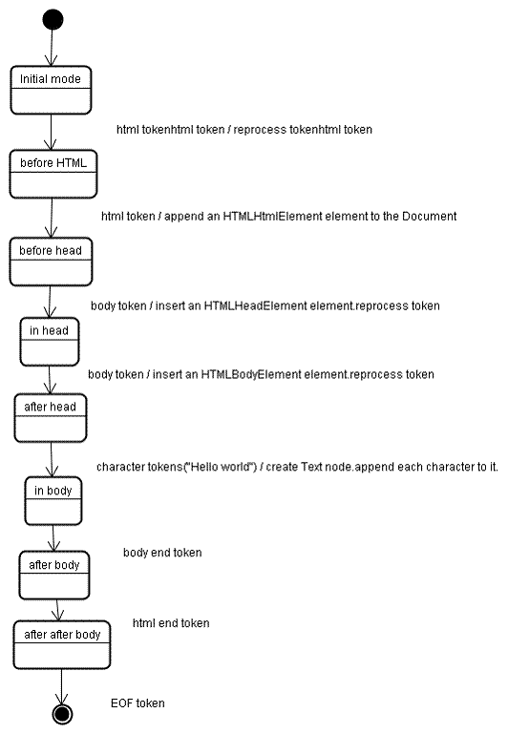
Tree construction algorithm

Slide 28
Work to do
A brief notes on:
Web Browser Software,
Using Browsers to Access Web Pages,
Customizing your Browser,
Images & Web Browsers.

